Slide 1
A COMPUTER VISION MODEL FOR DETECTING BONE FRACTURES IN THE UPPER EXTREMITIES
Notes:
The Human body is a deeply complex organism, so much so that people have dedicated their lives to understanding it. X-ray machines are a wonderful device which has greatly increased our insight into the human body, particularly that of our bones. With that being said, interpreting the images can be difficult for novice and trainee medical staff, especially when fractures in the bones are very small. The aim of this project is to aid in fracture classification so as to expedite treatment of fractures in the wrist, arm and shoulder.

Slide 2
PROBLEM STATEMENT:
Build an AI over the course of a week that detects bone
fractures in X-rays images at at least 85% accuracy to aid medical personnel in diagnosing fractures in the upper extremities and thus expediting treatment.
Notes:
Thus this project endeavored to Build an AI over the course of a week that detects bone fractures in X-rays images at at least 85% accuracy to aid medical personnel in diagnosing fractures in the upper extremities and thus expediting treatment.

Slide 3
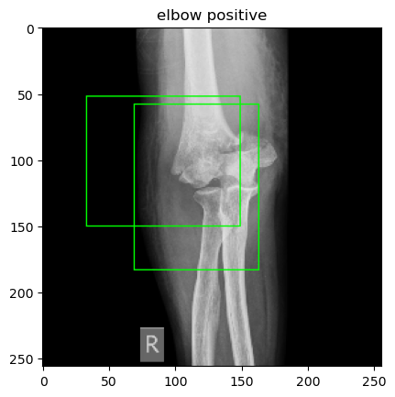
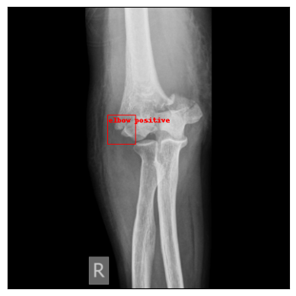
DATA WRANGLING
Notes:
Due to the data originating from Kaggle.com, It was really quite clean.
Too clean as a matter of fact as will be described later in the EDA section.
There was a large body of approximately
8000 X-ray images for training, an extra
2000 for Validating (an important part of Computer Vision modeling as will be described later) and another
169 images for testing the model.
- In the process of initial training of the model it became clear that hidden in this mass of data there were in fact errors and anomalies which needed to be addressed in order to improve modeling and performance.
- The first error being: there was no classification for ‘no fracture detected’ These annotations were simply empty .txt files for which I provided an acceptable null value for the bounding boxes and for classification.
- The other common errors found were extra boundaries for bounding box data.
- This was caused due to the annotations trying to cover too much ground per se.
- There are three ways to annotate a bounding box and these annotations endeavored to cover all of them with the only delimiter between the data points being a space.
- Although I knew that a .json file would have served this functionality better, which at its heart is a good idea, it was well outside of the scope and time limitations set for this project and thus in importing data with my __getitem__ method of my dataset class, I had to instantiate a series of logic gates to address the discrepancies in annotation data.

Slide 4
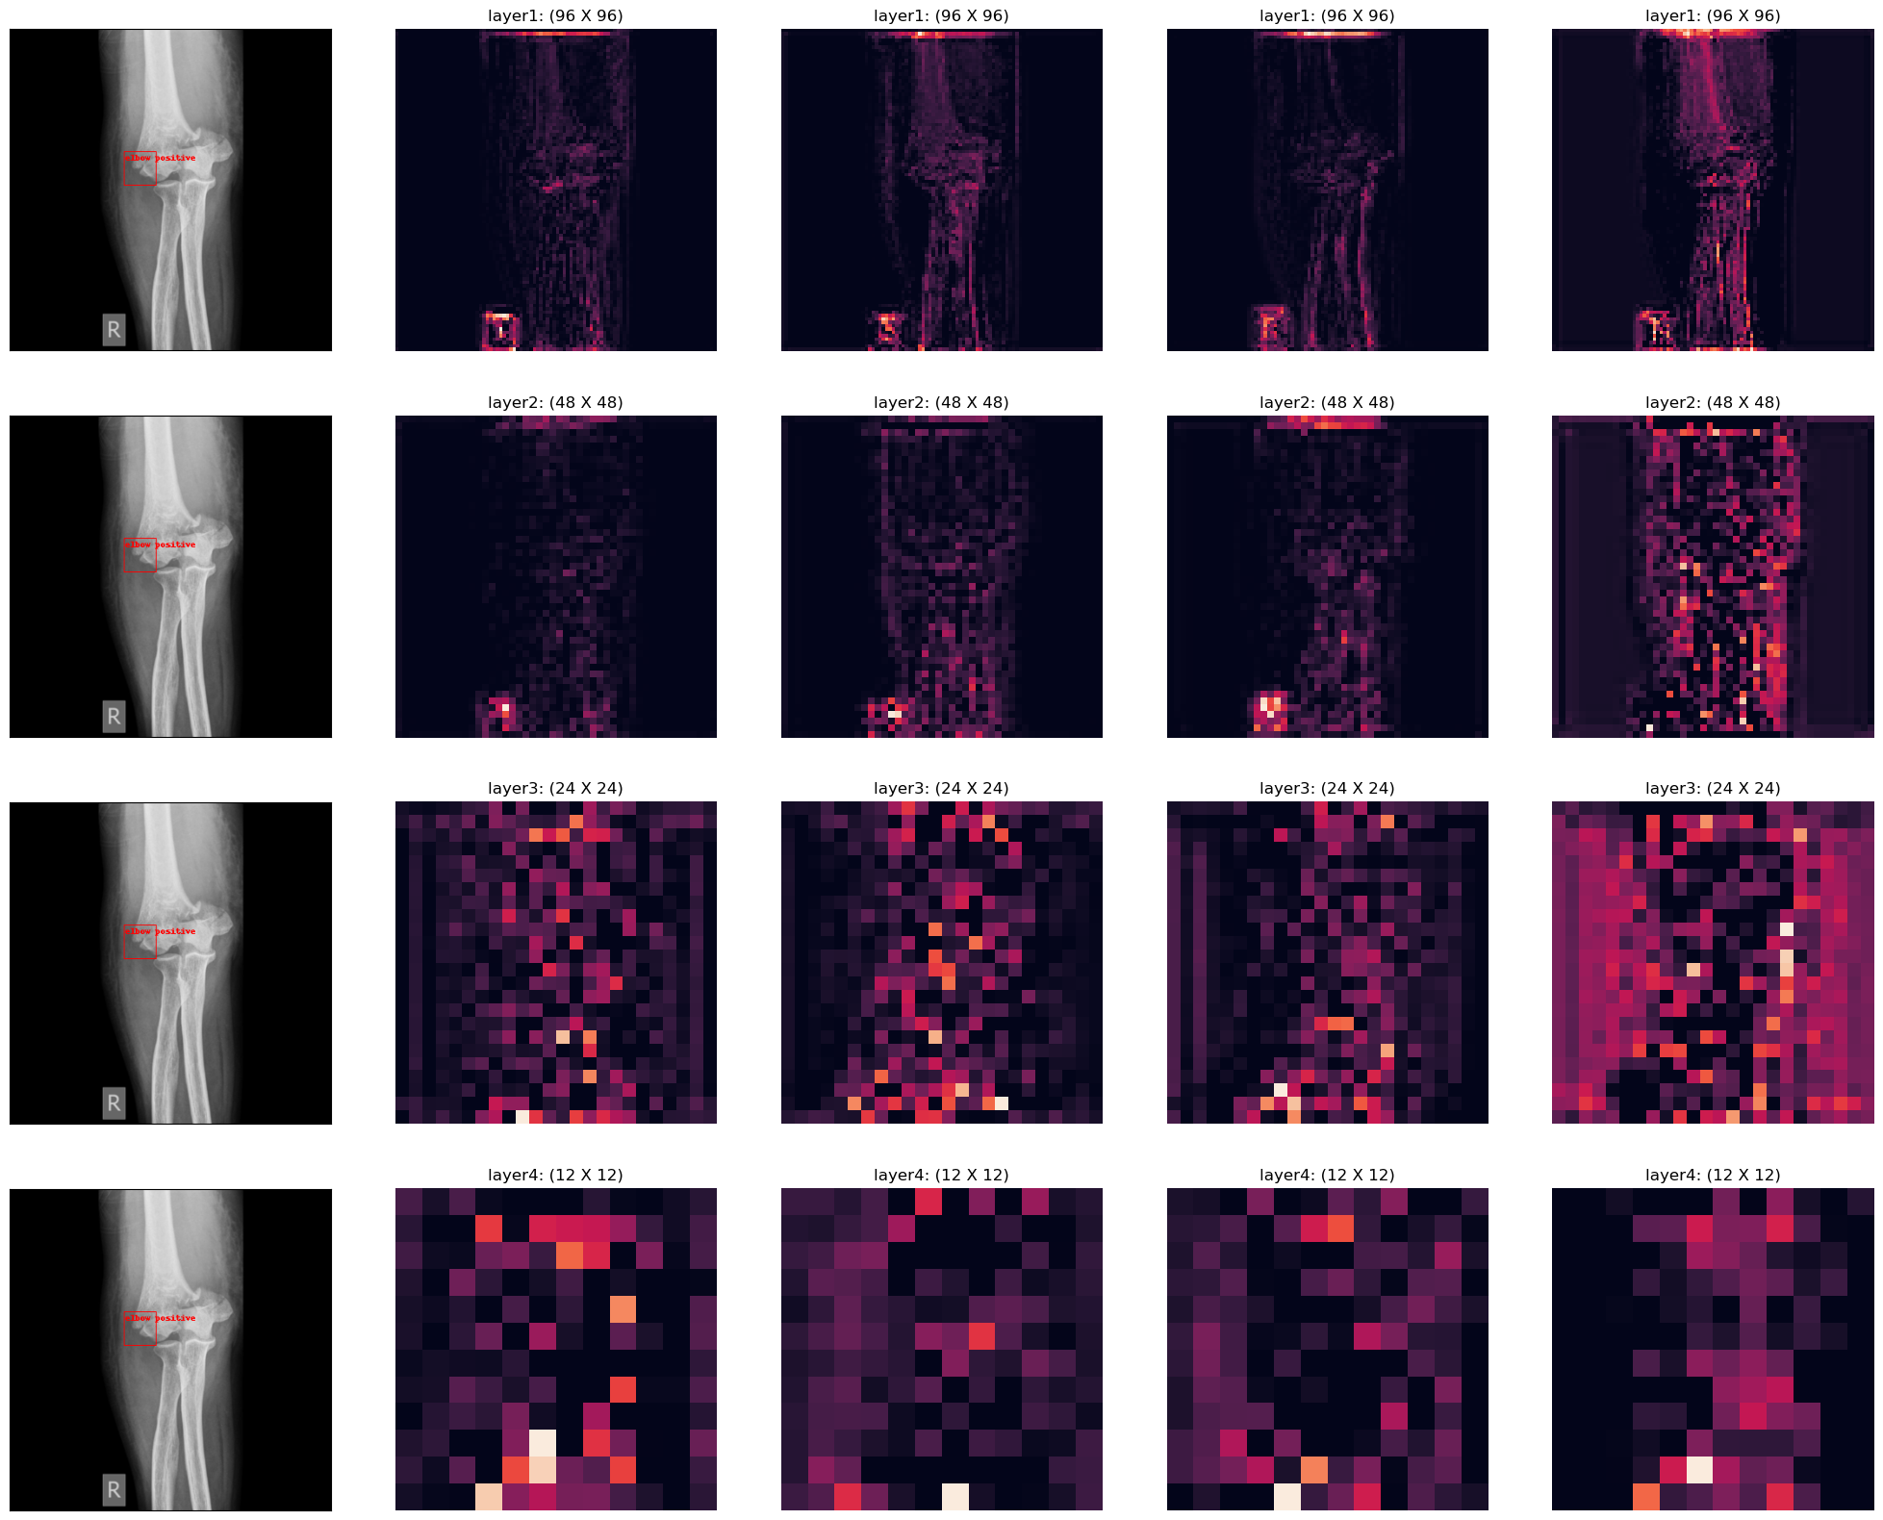
EXPLORATORY DATA ANALYSIS/FEATURE ENGINEERING
Notes:
Highlight difference in performing EDA for images as opposed for tabular data
Explain how Neural Networks ‘see’ data
Be prepared for the different types of image manipulation algorithms that exist in Python SKLearn and SKImage as well as PyTorch.

Slide 5
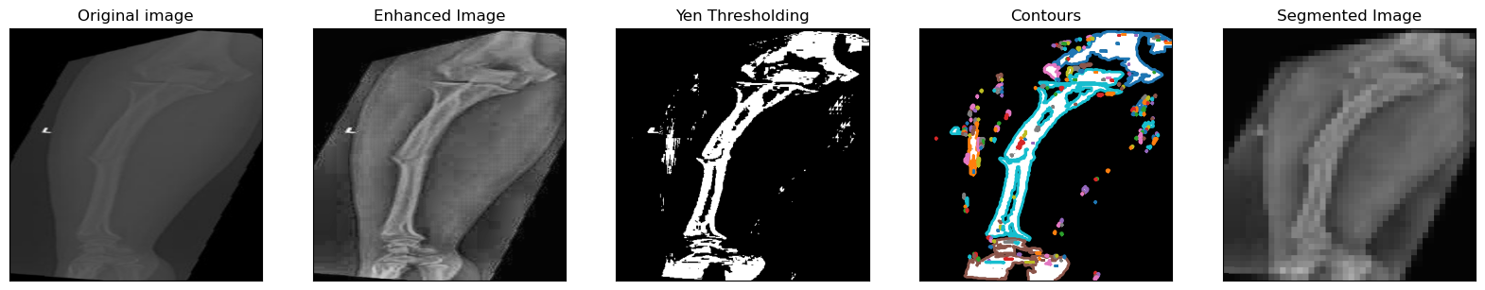
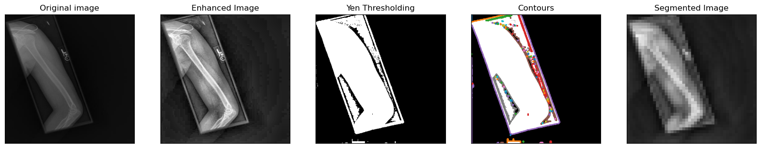
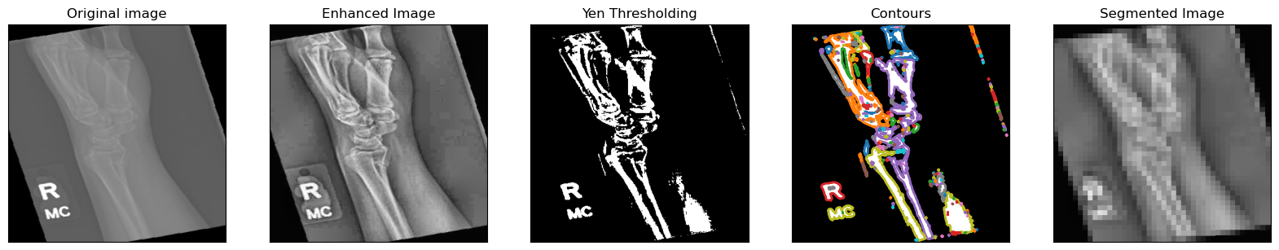
WHY A DEEP LEARNING SOLUTION RATHER THAN A MACHINE LEARNING MODEL
Notes:
Talk about the simplicity of image transformation and detection for SKImage.
Talk about the different types of transformation and their benefits
Talk about why not having a consistent mode of thresholding defeats the whole process.
Explain about the power of Neural Network to do a finer analysis of the image.

Slide 6
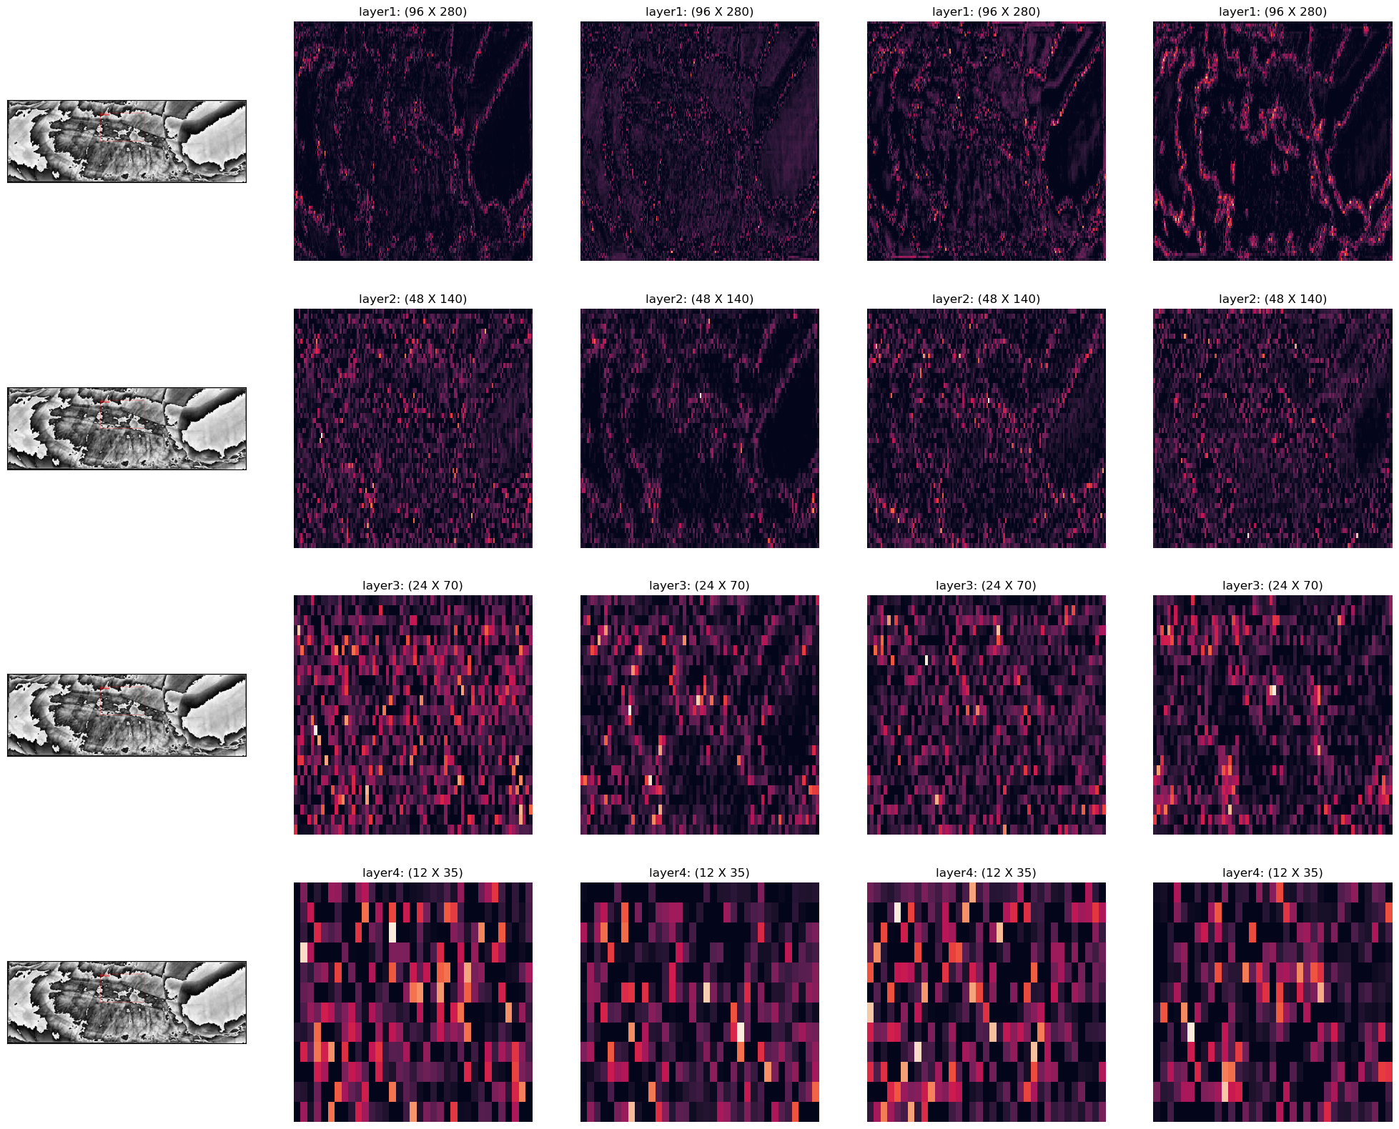
MODEL PRE-PROCESSING
transforms.Resize(224)
transform.ToTensor()
transforms.RandomAutocontrast(0.1)
transforms.RandomAdjustSharpness(0.1)
transforms.RandomErasing(0.1)
transforms.RandomHorizontalFlip(0.1)
transforms.RandomInvert(0.1)
Notes:
Talk about the need for image shape to be consistent when feeding it to the model
Talk about the difference between tensors and nd.arrays
Talk about enhancement transformation and the need to muddy the water with the image data to prevent over-fitting.

Slide 7
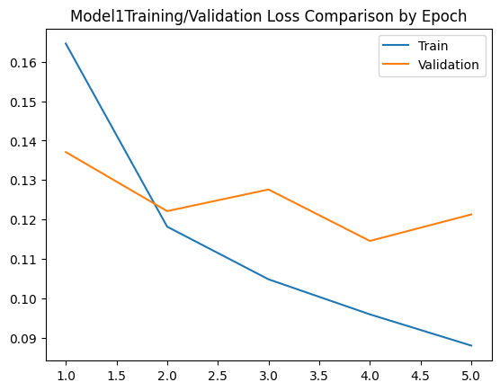
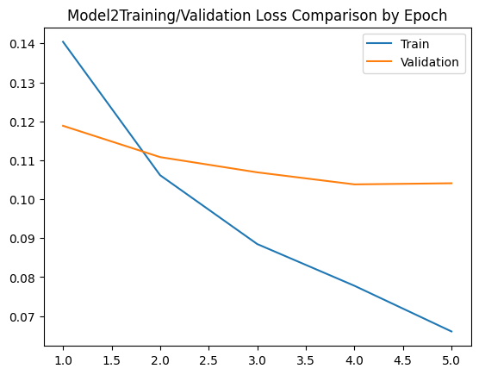
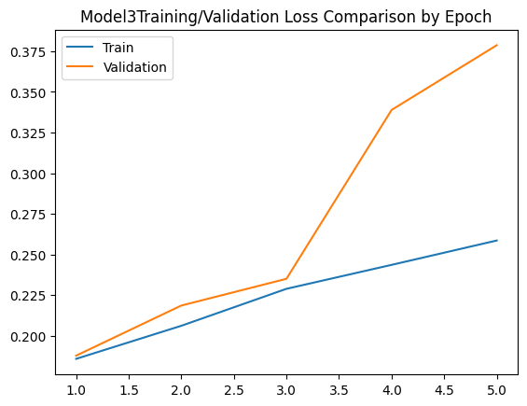
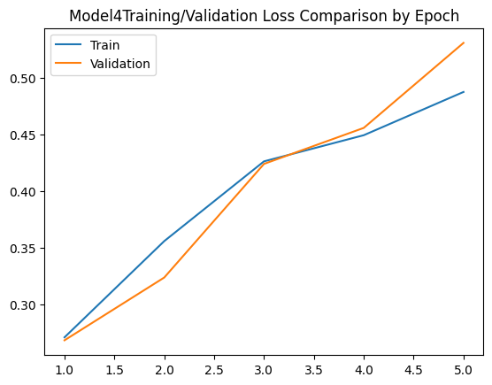
MODELING: FOUR FASTER RCNN NETWORKS WITH DIFFERENT STRENGTHS
Notes:
Fasterrcnn_resnet50_fpn = Model1
Fasterrcnn_resnet50_fpn_v2 = Model2
Fasterrcnn_mobilenet_v3_large_fpn = Model3
Fasterrcnn_mobilenet_v3_large_320_fpn = Model4
Talk about the difficulty in training these models due to limited resources
Talk about why only 5 epochs; explain an epoch if necessary
Talk about back propagation if necessary
Explain the validation set and how to determine model performance and over-fitting.

Slide 8
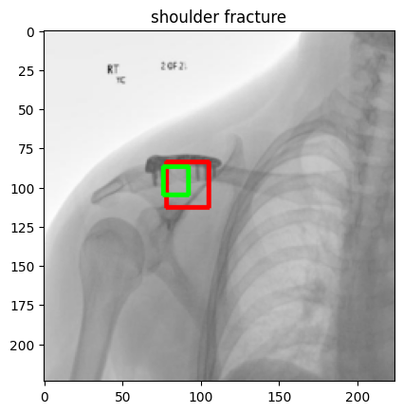
FINAL THOUGHTS
Notes:
Describe your model selection and defend it. (Fasterrcnn_resnet50_fpn_v2 = Model2)
Explain that due to the expansiveness of the project data set, the only way to improve upon the %92 performance from this model is to fine tune the multitude of convolutional layers
Be ready to take questions as necessary
About pytorch
About the decisions and assumptions you made during the course
About CUDA cores not being optimized for clearing out old data to train multiple models in a series on the same GPU.

